Slide 1
Analysis of Lumi Counters for June ‘23 MuScan
Omar Sayeed Saimum [Saimum]
omars.saimum@kaist.ac.kr/cern.ch
3rd year undergraduate student
Dept. of Physics, KAIST, Daejeon, South Korea
Intern, Luminosity group of LHCb, LLR, Ecole Polytechnique, France
14th December 2023

Slide 2
Info on the Data & the Filling Scheme
June Mu Scan -> Fill: 9007
Contains 16 bbs, 124 bes and ebs, and 3300 ees
No bunch trains; Long ee trains; only ee appears after bb.
Plume mu: 1.06 to 8.41
Mu from VeloTracks upto ~5.7 & still sufficient for LogZero.

Slide 3
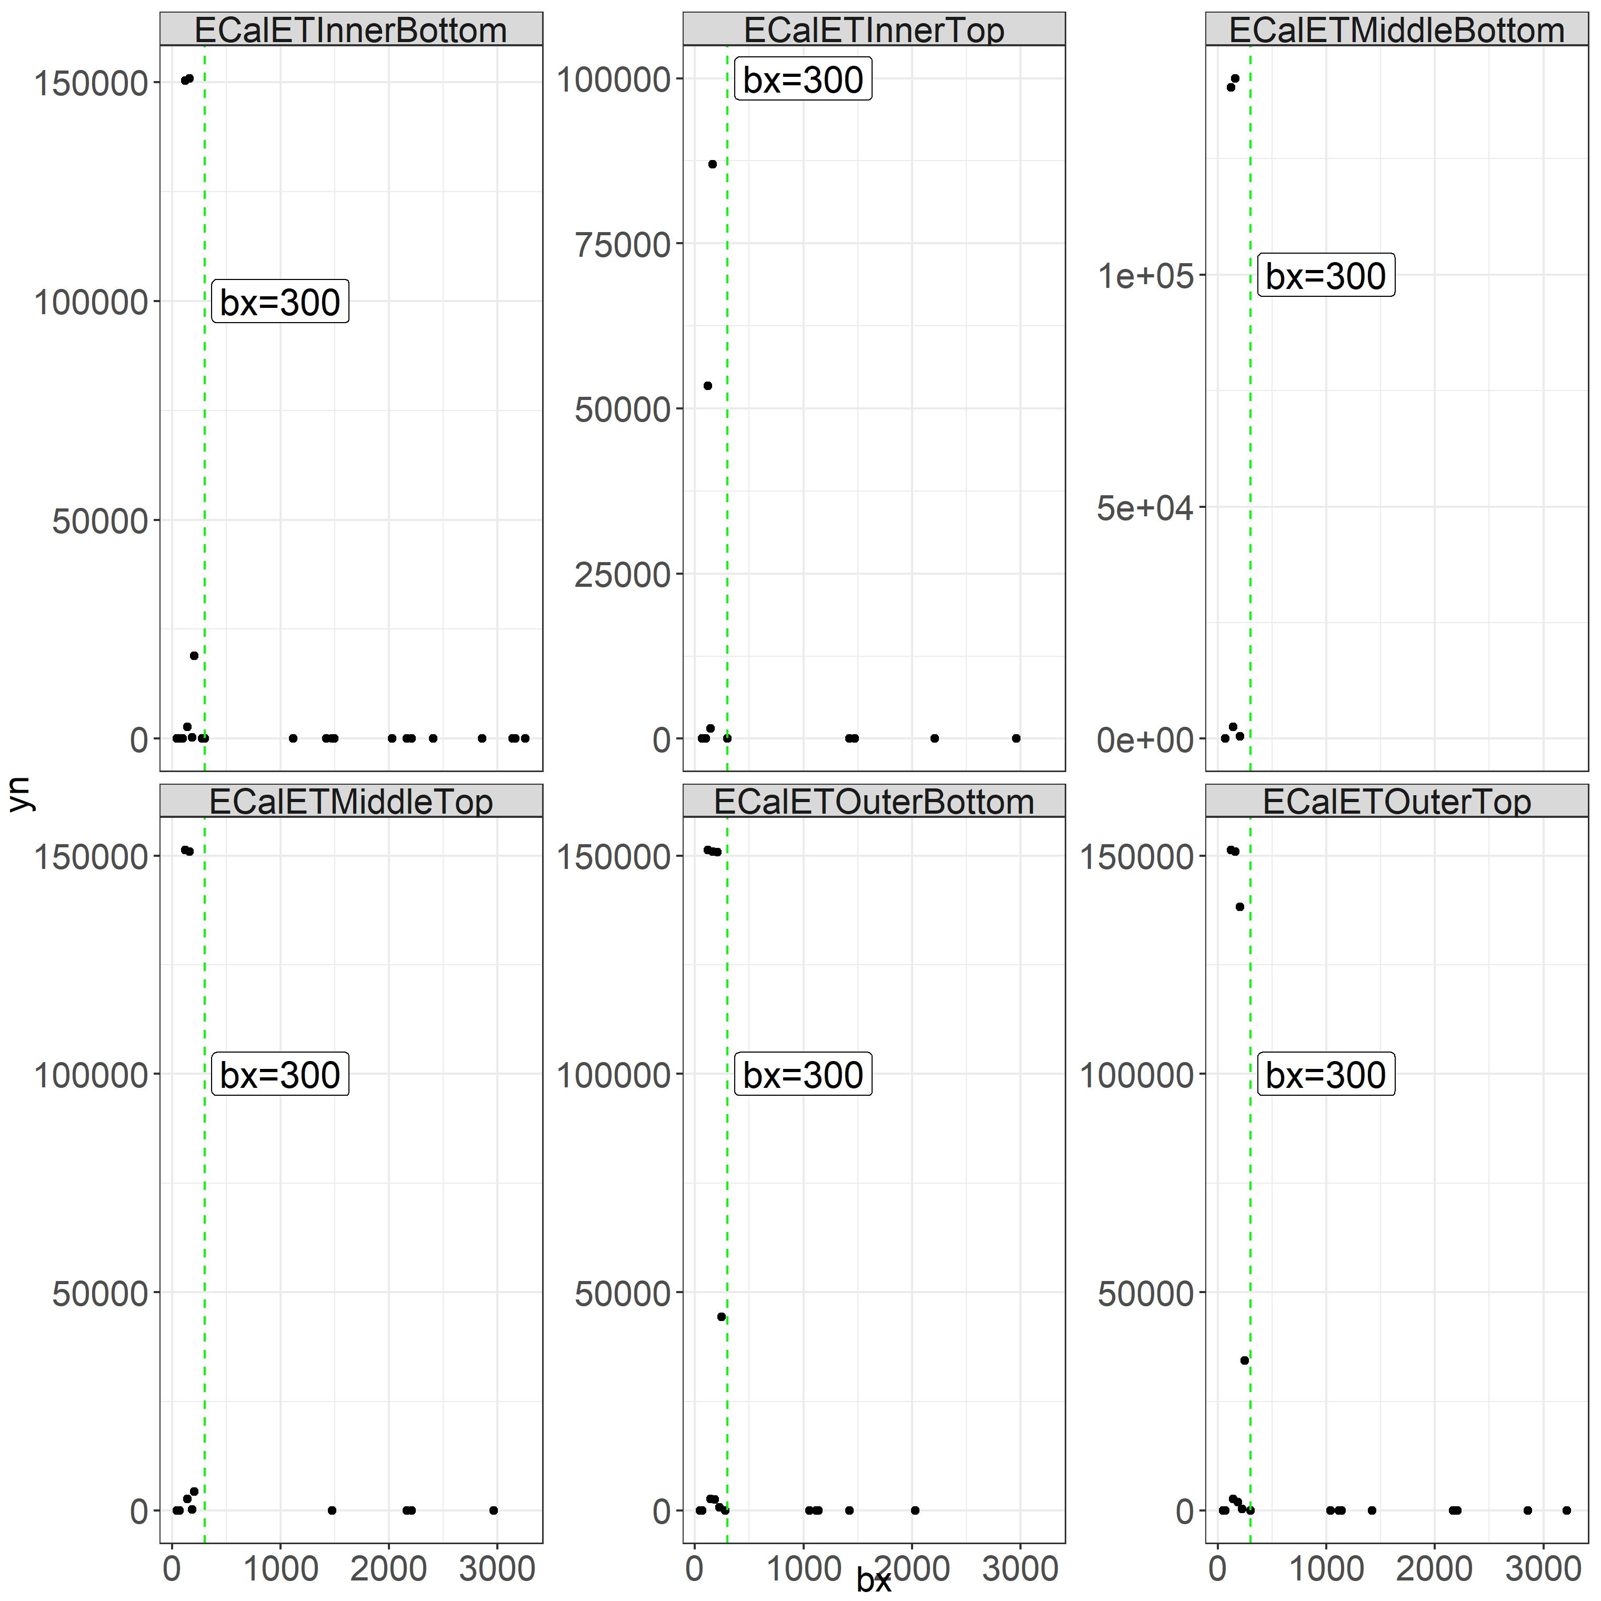
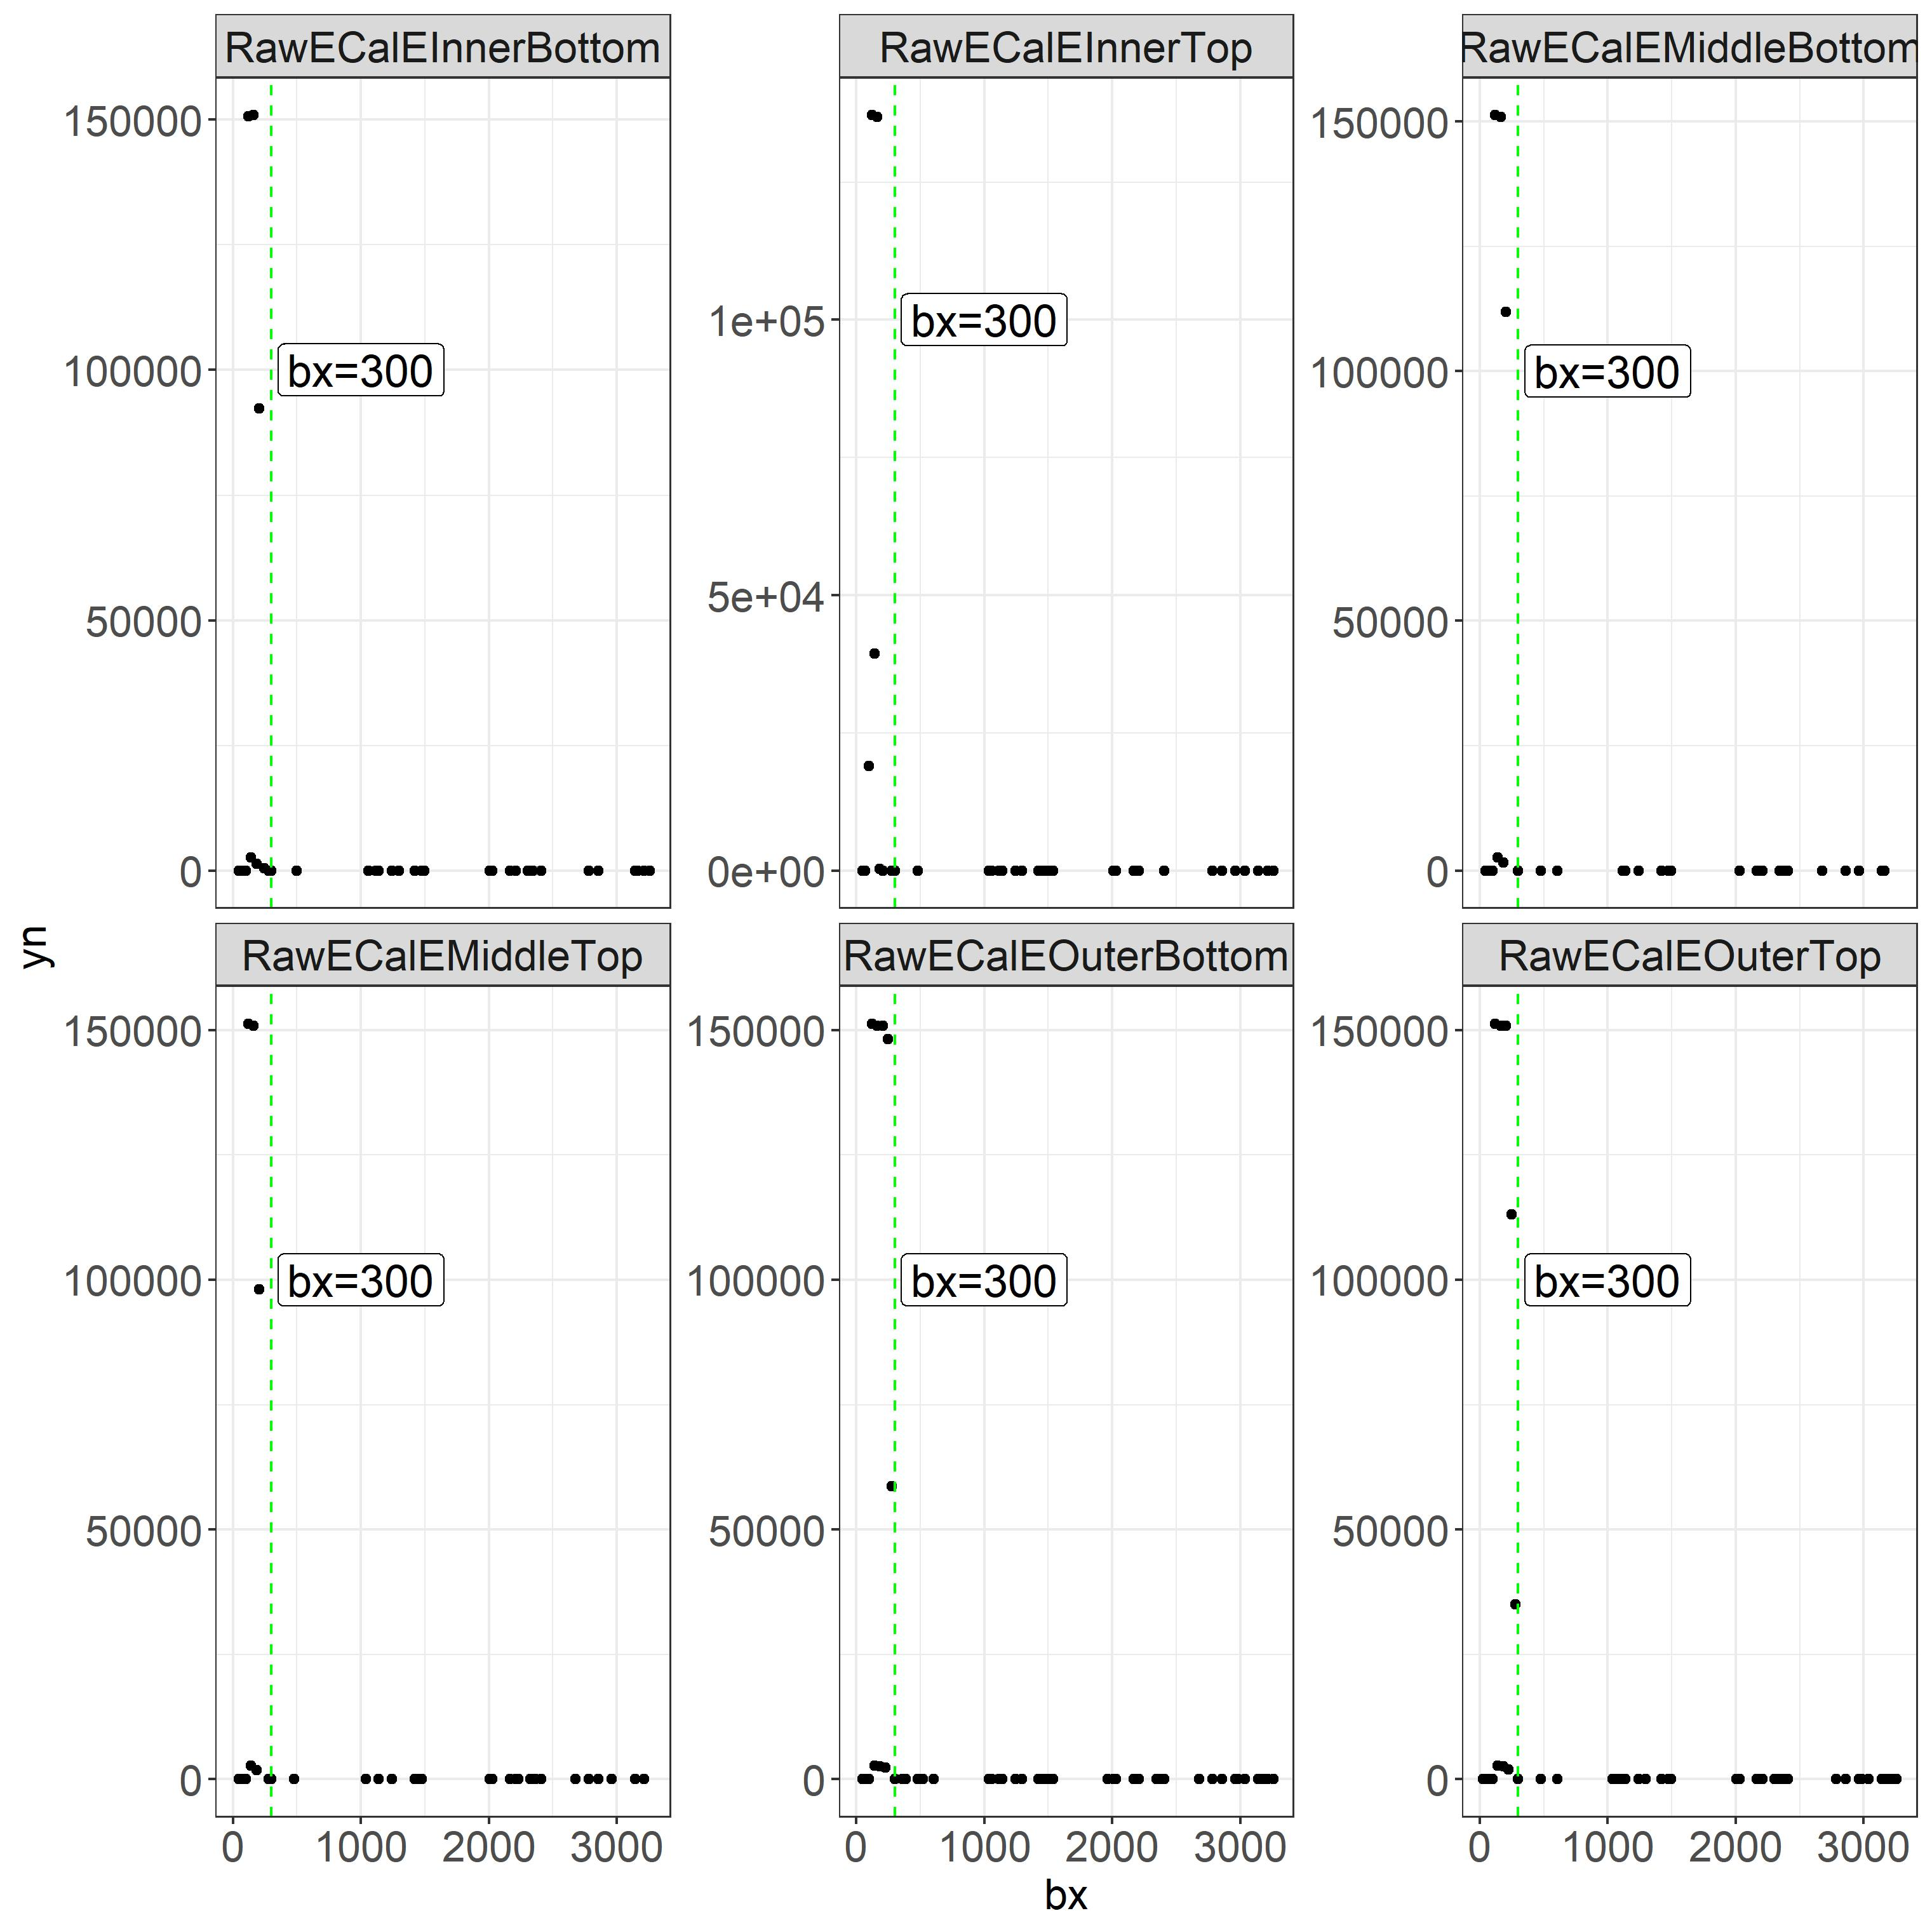
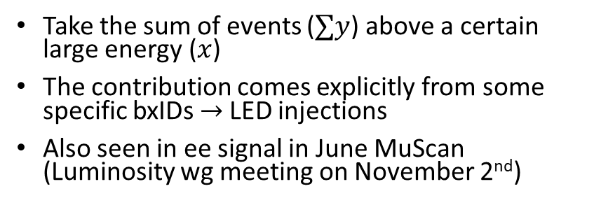
LED injections in be/eb
Take the sum of events ($∑y$) above a certain large energy ($x$)
The contribution comes explicitly from some specific bxIDs $→$ LED injections
Also seen in ee signal in June MuScan (Luminosity wg meeting on November 2nd)

Slide 4
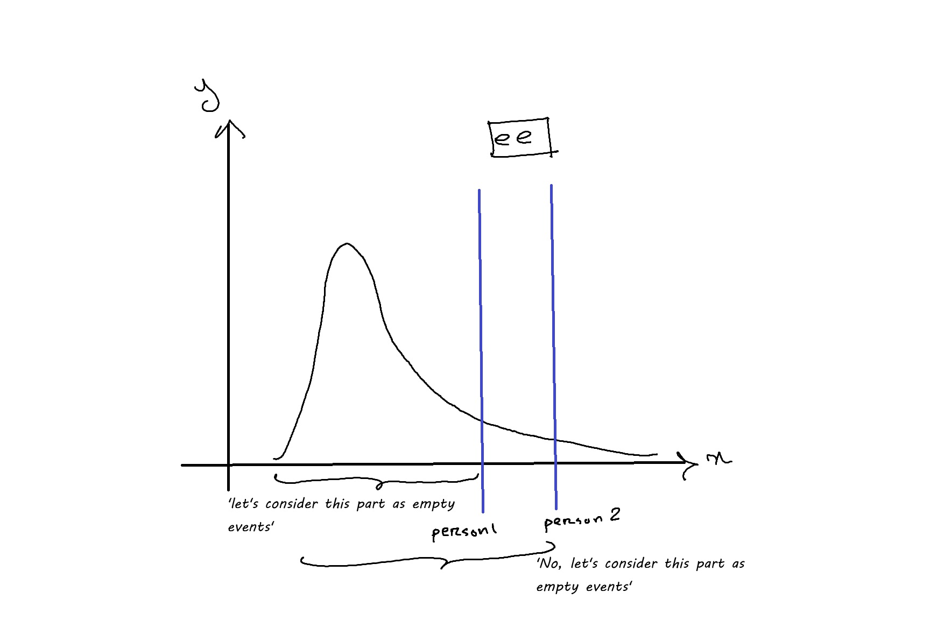
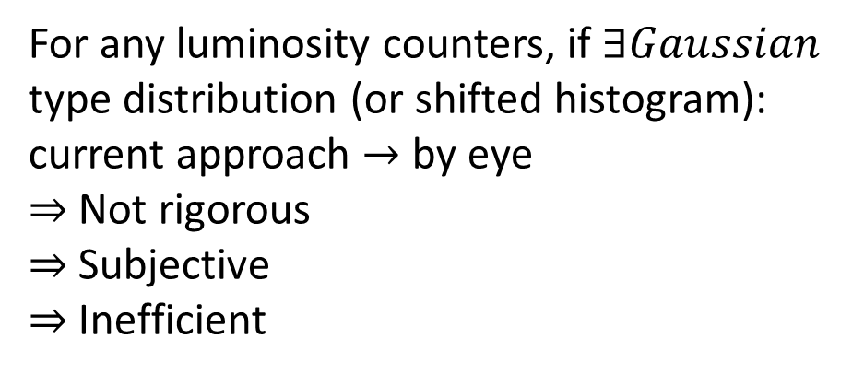
Determining Empty Events
For any luminosity counters, if $∃Gaussian$ type distribution (or shifted histogram): current approach $→$ by eye
$⇒$ Not rigorous
$⇒$ Subjective
$⇒$ Inefficient

Slide 5
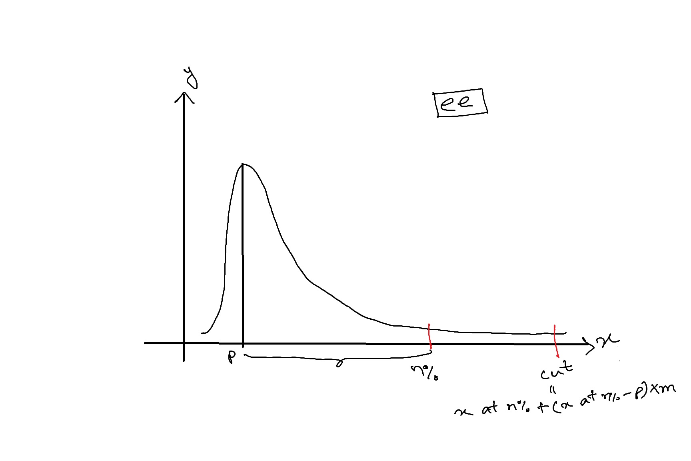
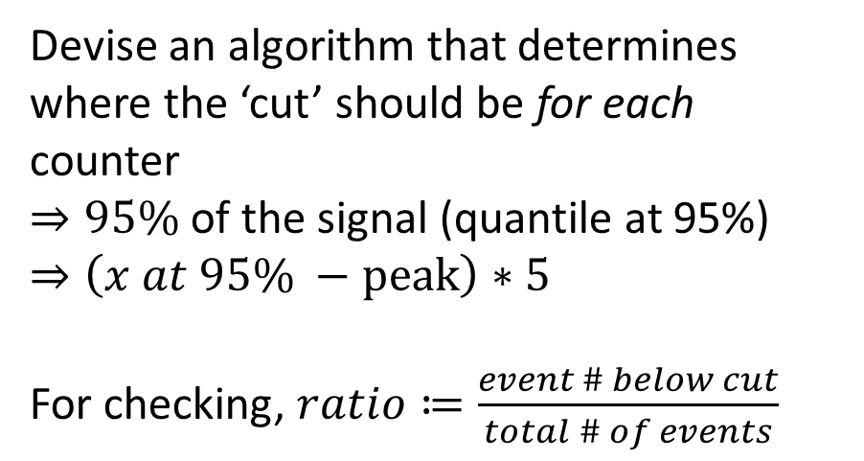
Proposed Generalized Cut Function
Devise an algorithm that determines where the ‘cut’ should be for each counter
$⇒95\%$ of the signal (quantile at 95%)
$⇒\left(x at 95\% −peak\right)∗5$
For checking, $ratio≔\frac{event \# below cut}{total \# of events}$

Slide 6
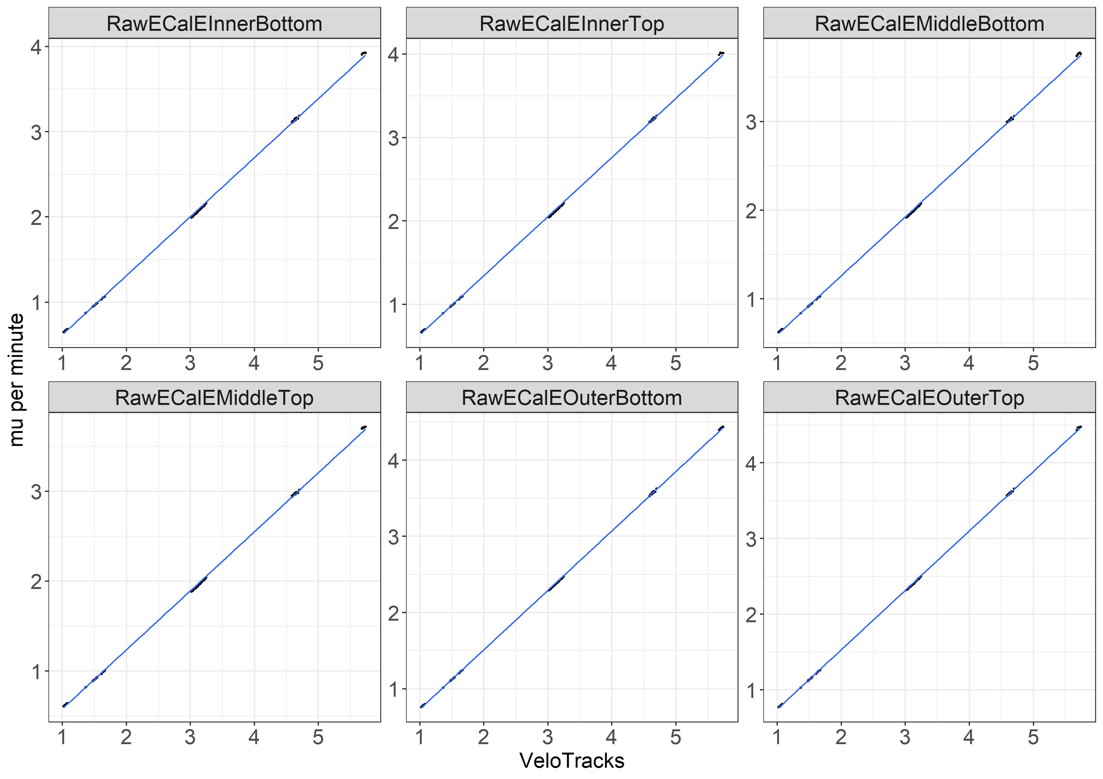
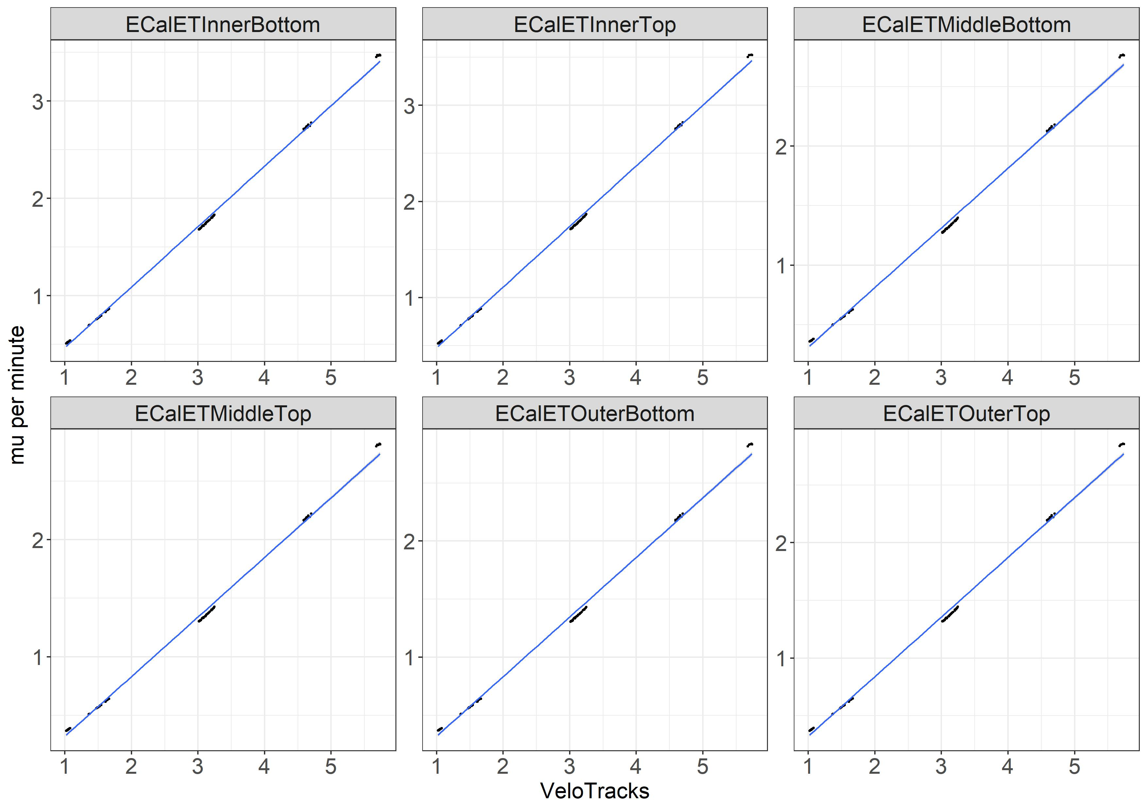
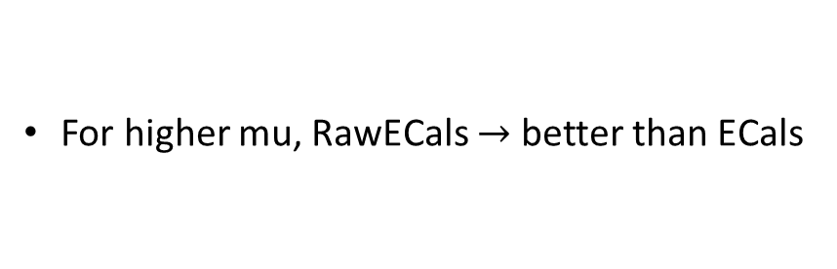
Linearity of RawECals and ECals vs. VeloTracks
For higher mu, RawECals $→$ better than ECals

Slide 7
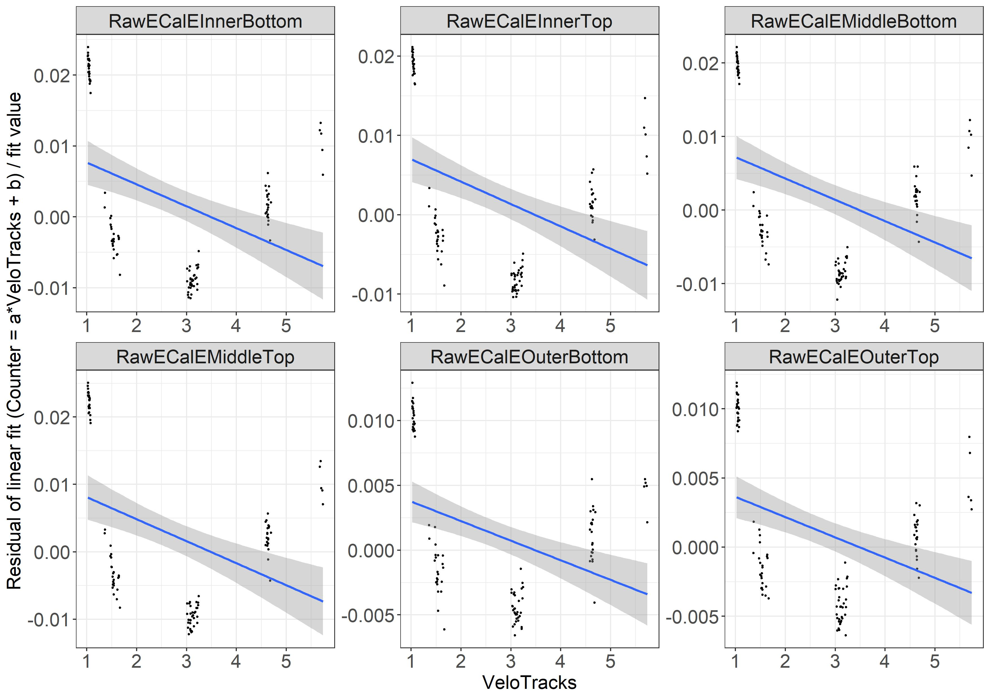
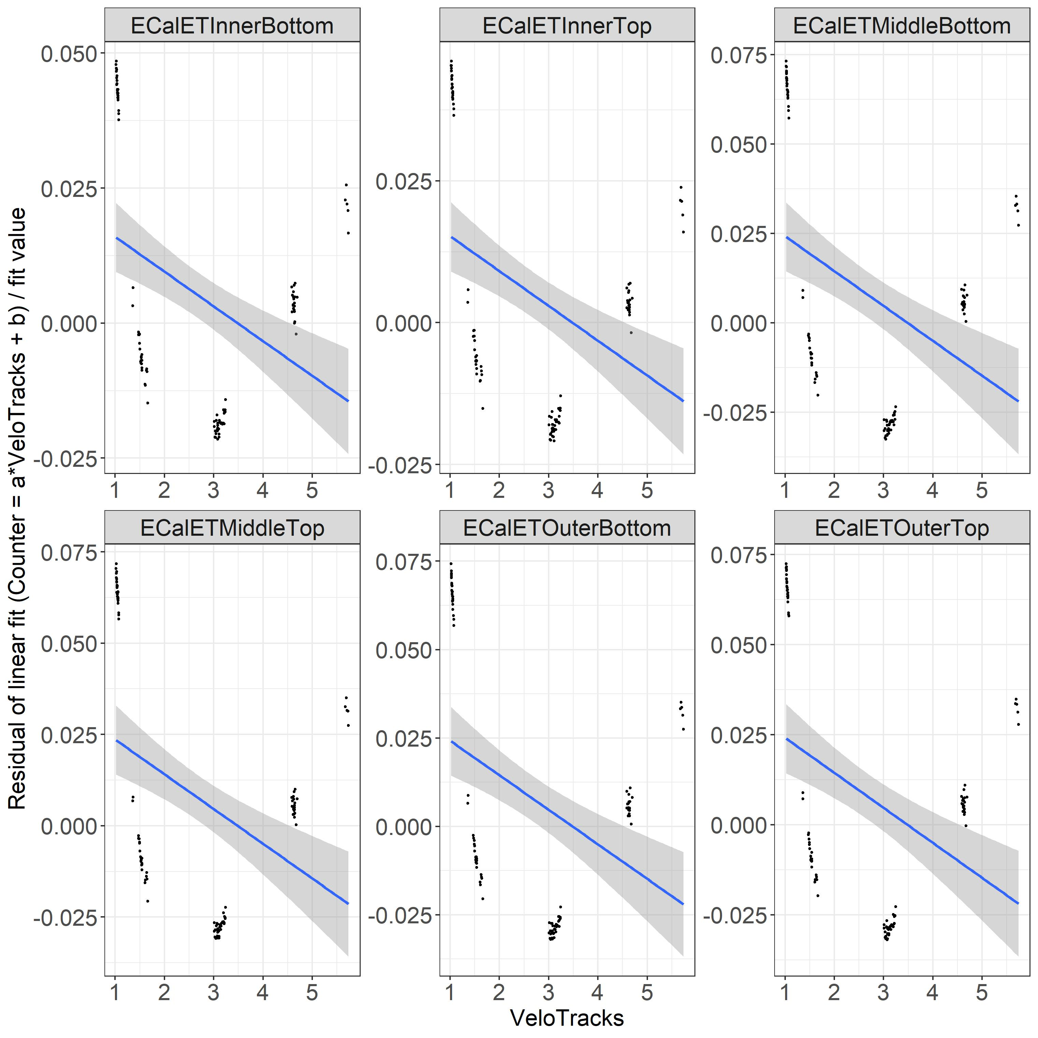
Relative residuals of the linear fit for ECals and RawECals vs. VeloTracks
RawECals overall gives better relative residuals (around 1-2% vs. 3-8% for ECals)
Note the offset is NOT zero.

Slide 8
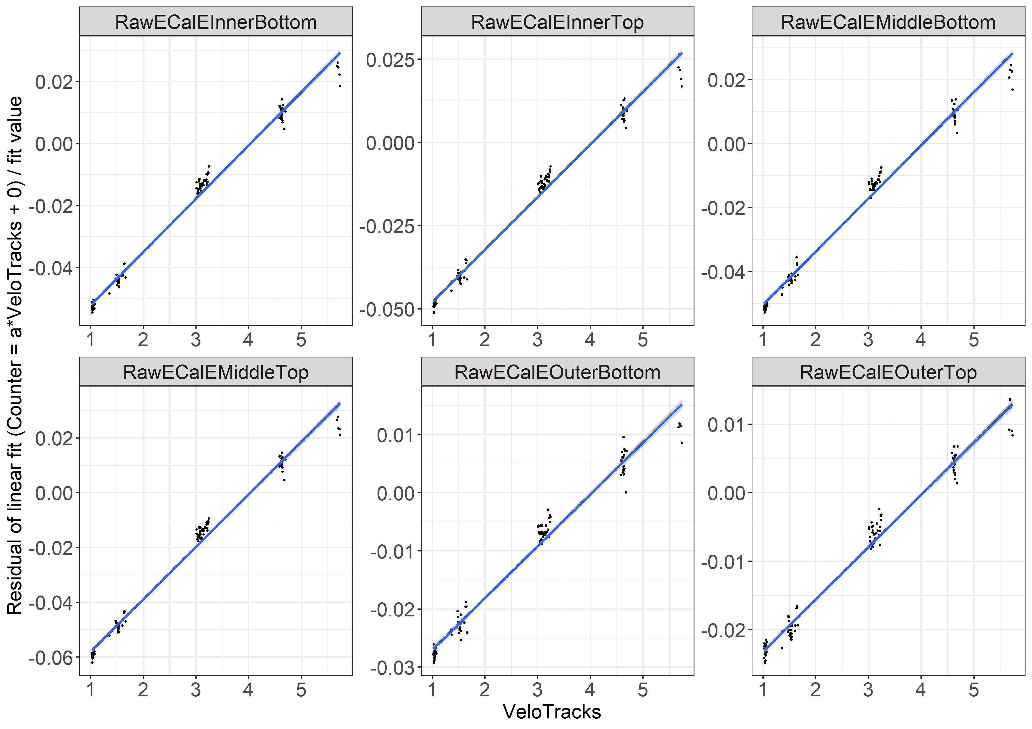
Offset = 0 vs. offset != 0 for RawECals
Linear relationship in lower mu
Quadratic relationship w/ increasing mu

Slide 9
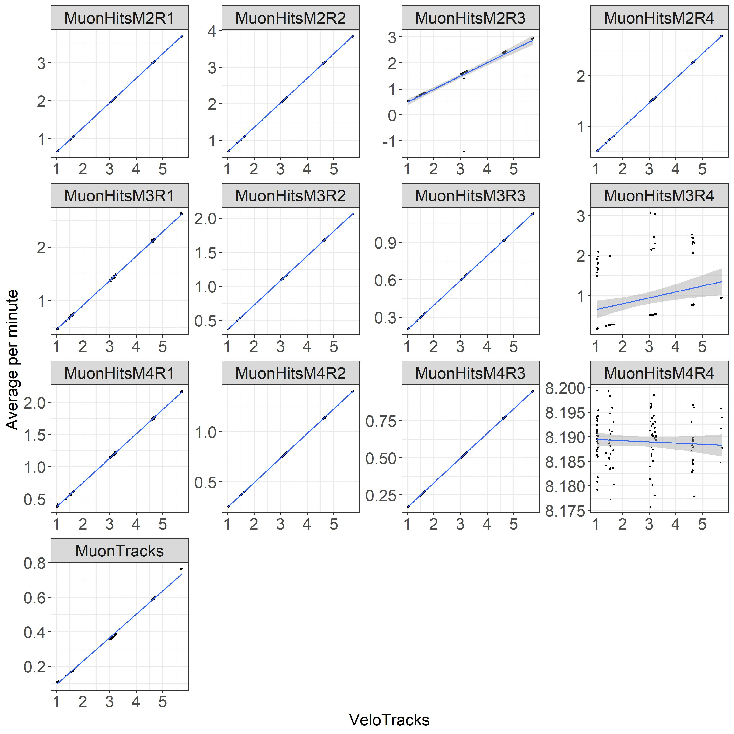
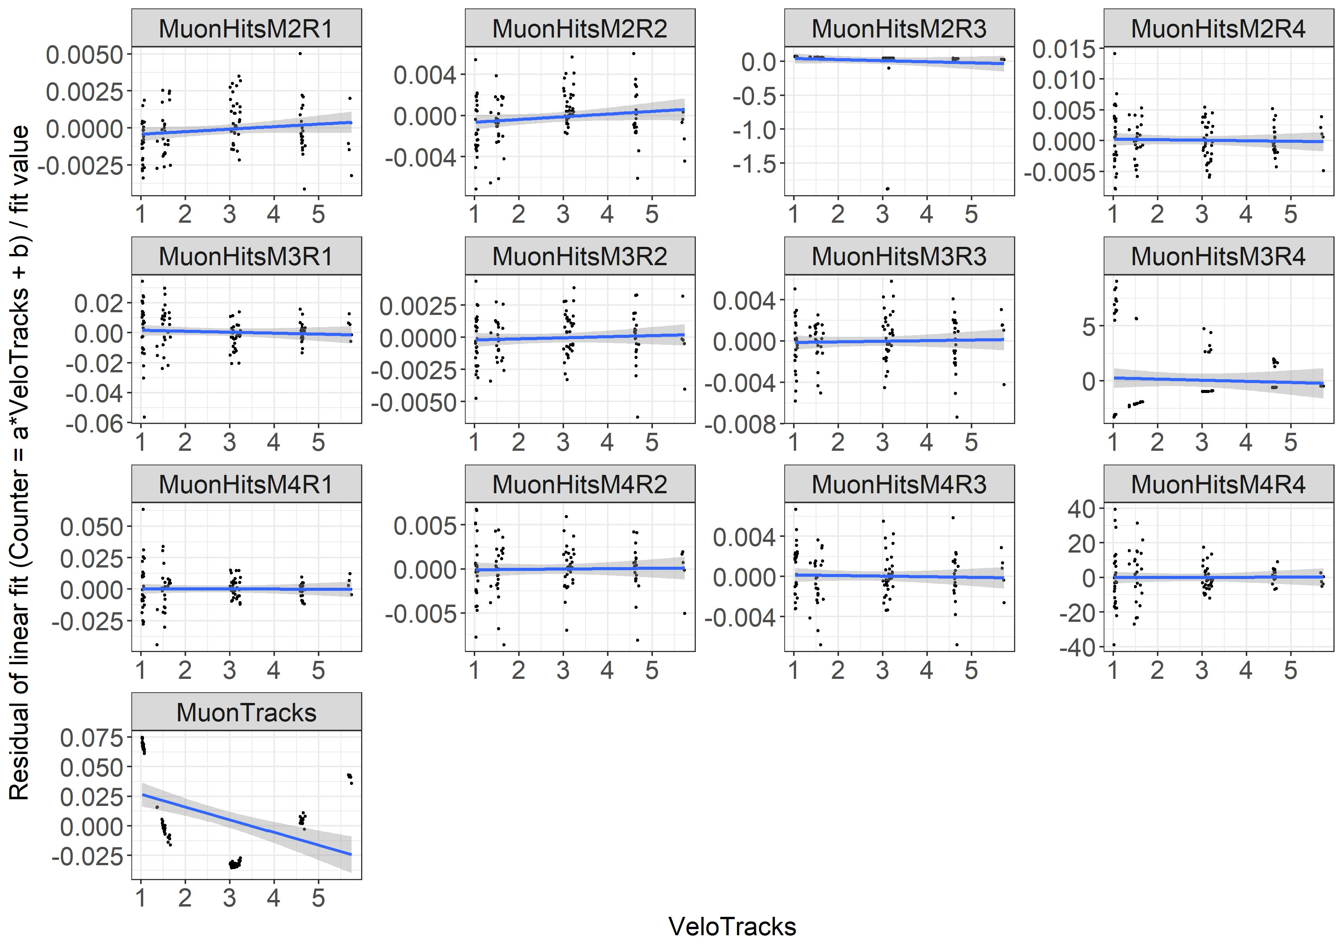
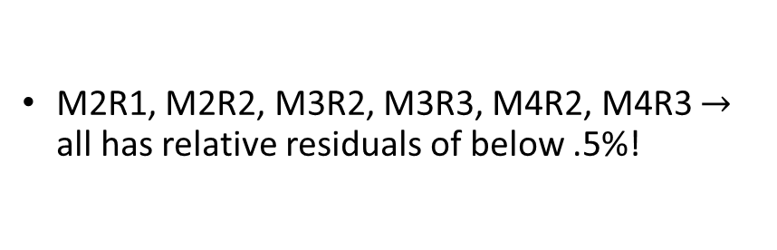
Linear fit & its relative residual for Muons vs. VeloTracks
M2R1, M2R2, M3R2, M3R3, M4R2, M4R3 $→$ all has relative residuals of below .5%!

Slide 10
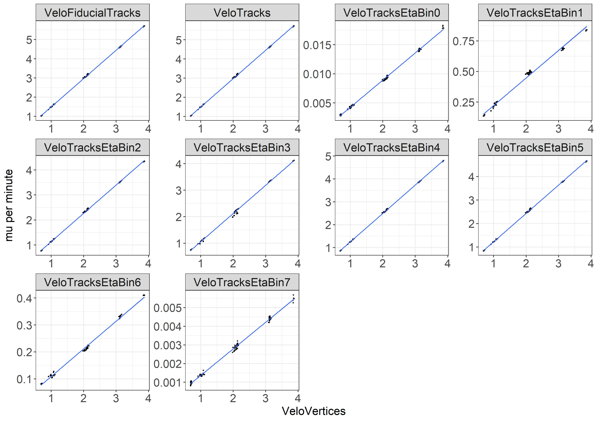
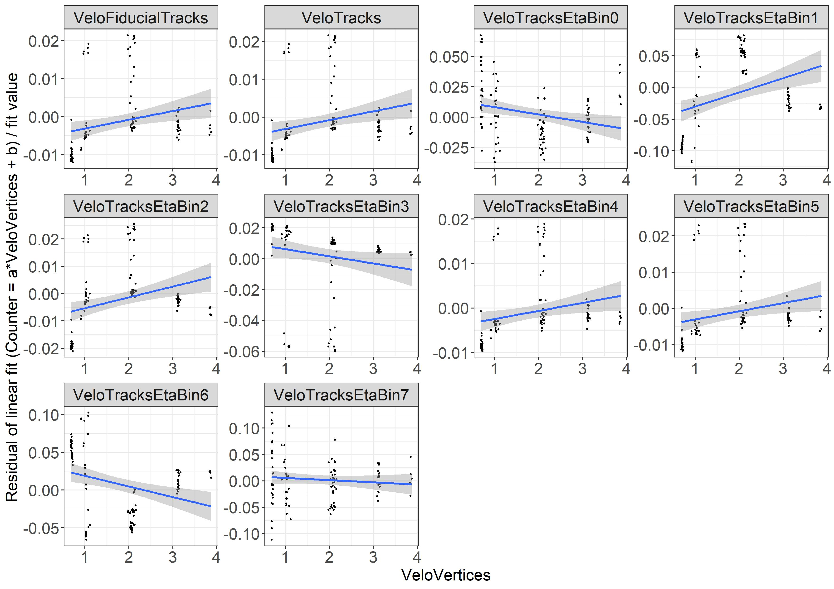

VeloTracks vs. VeloVertices
VeloTracks vs. VeloVertices $→$ relative residuals of linearity similar to RawECals

Slide 11
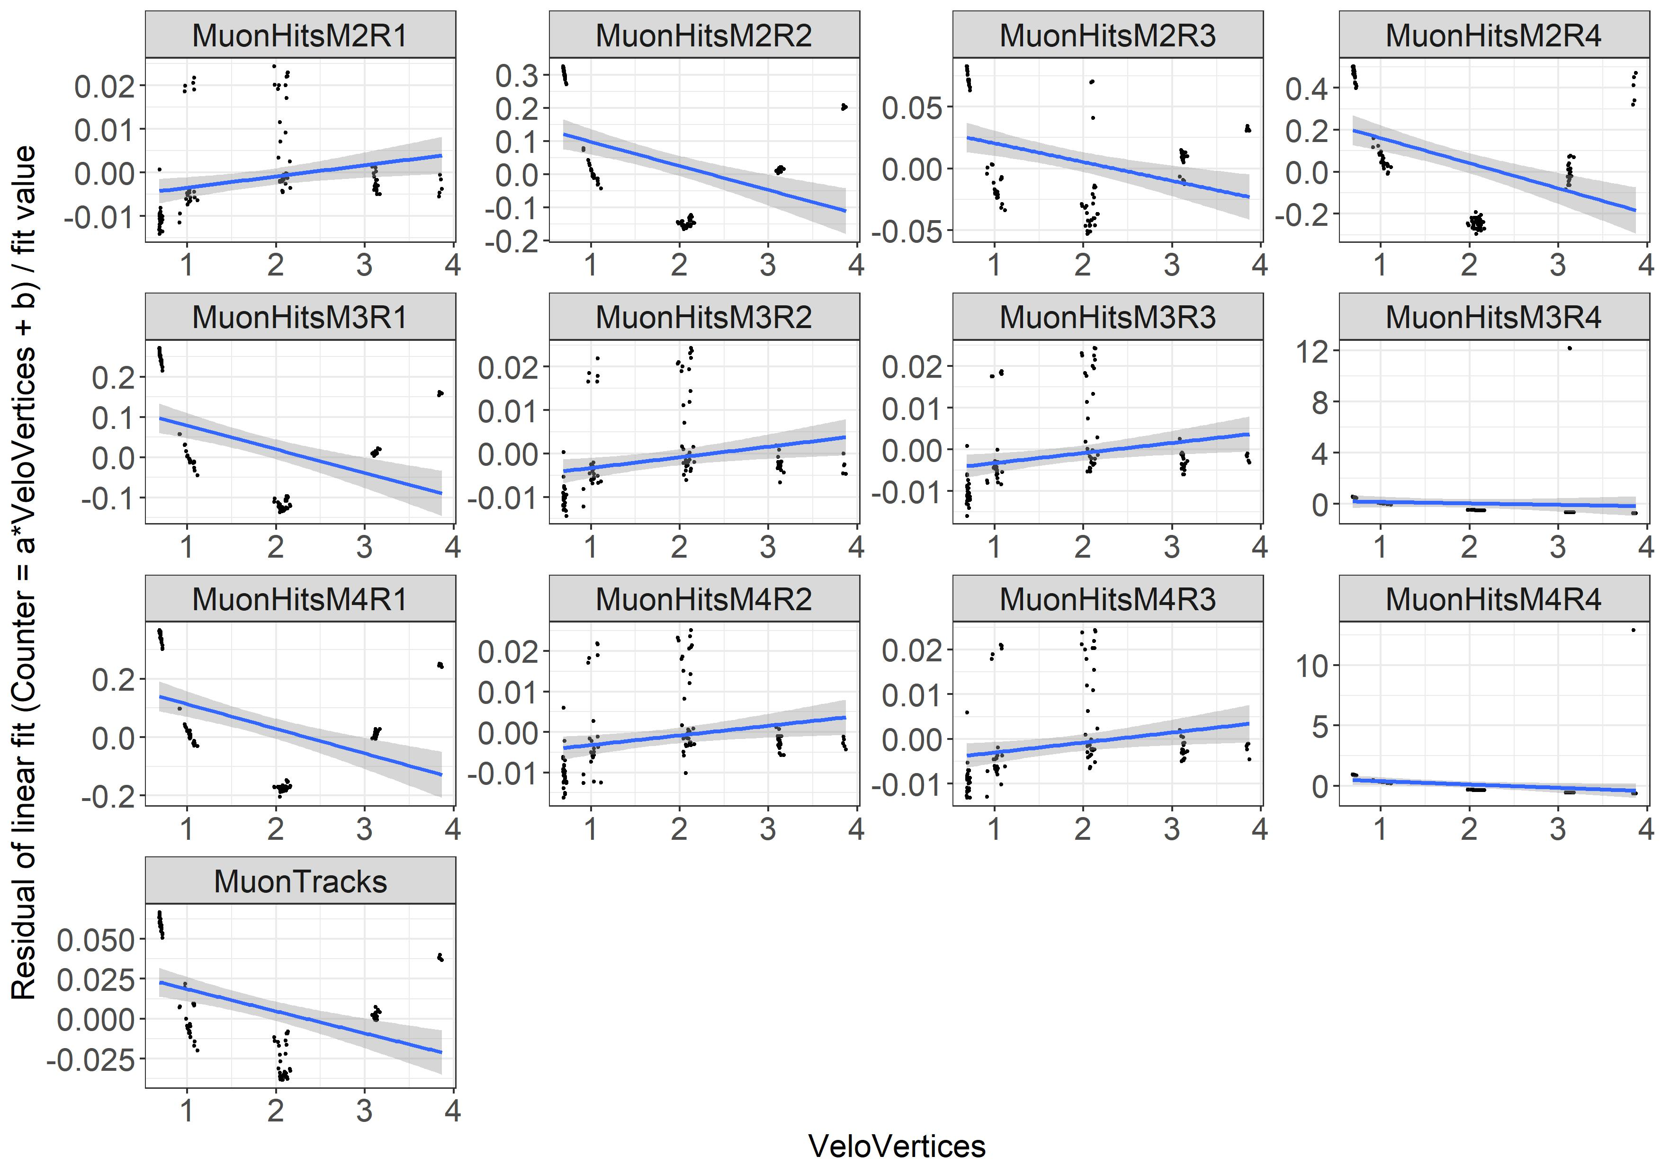
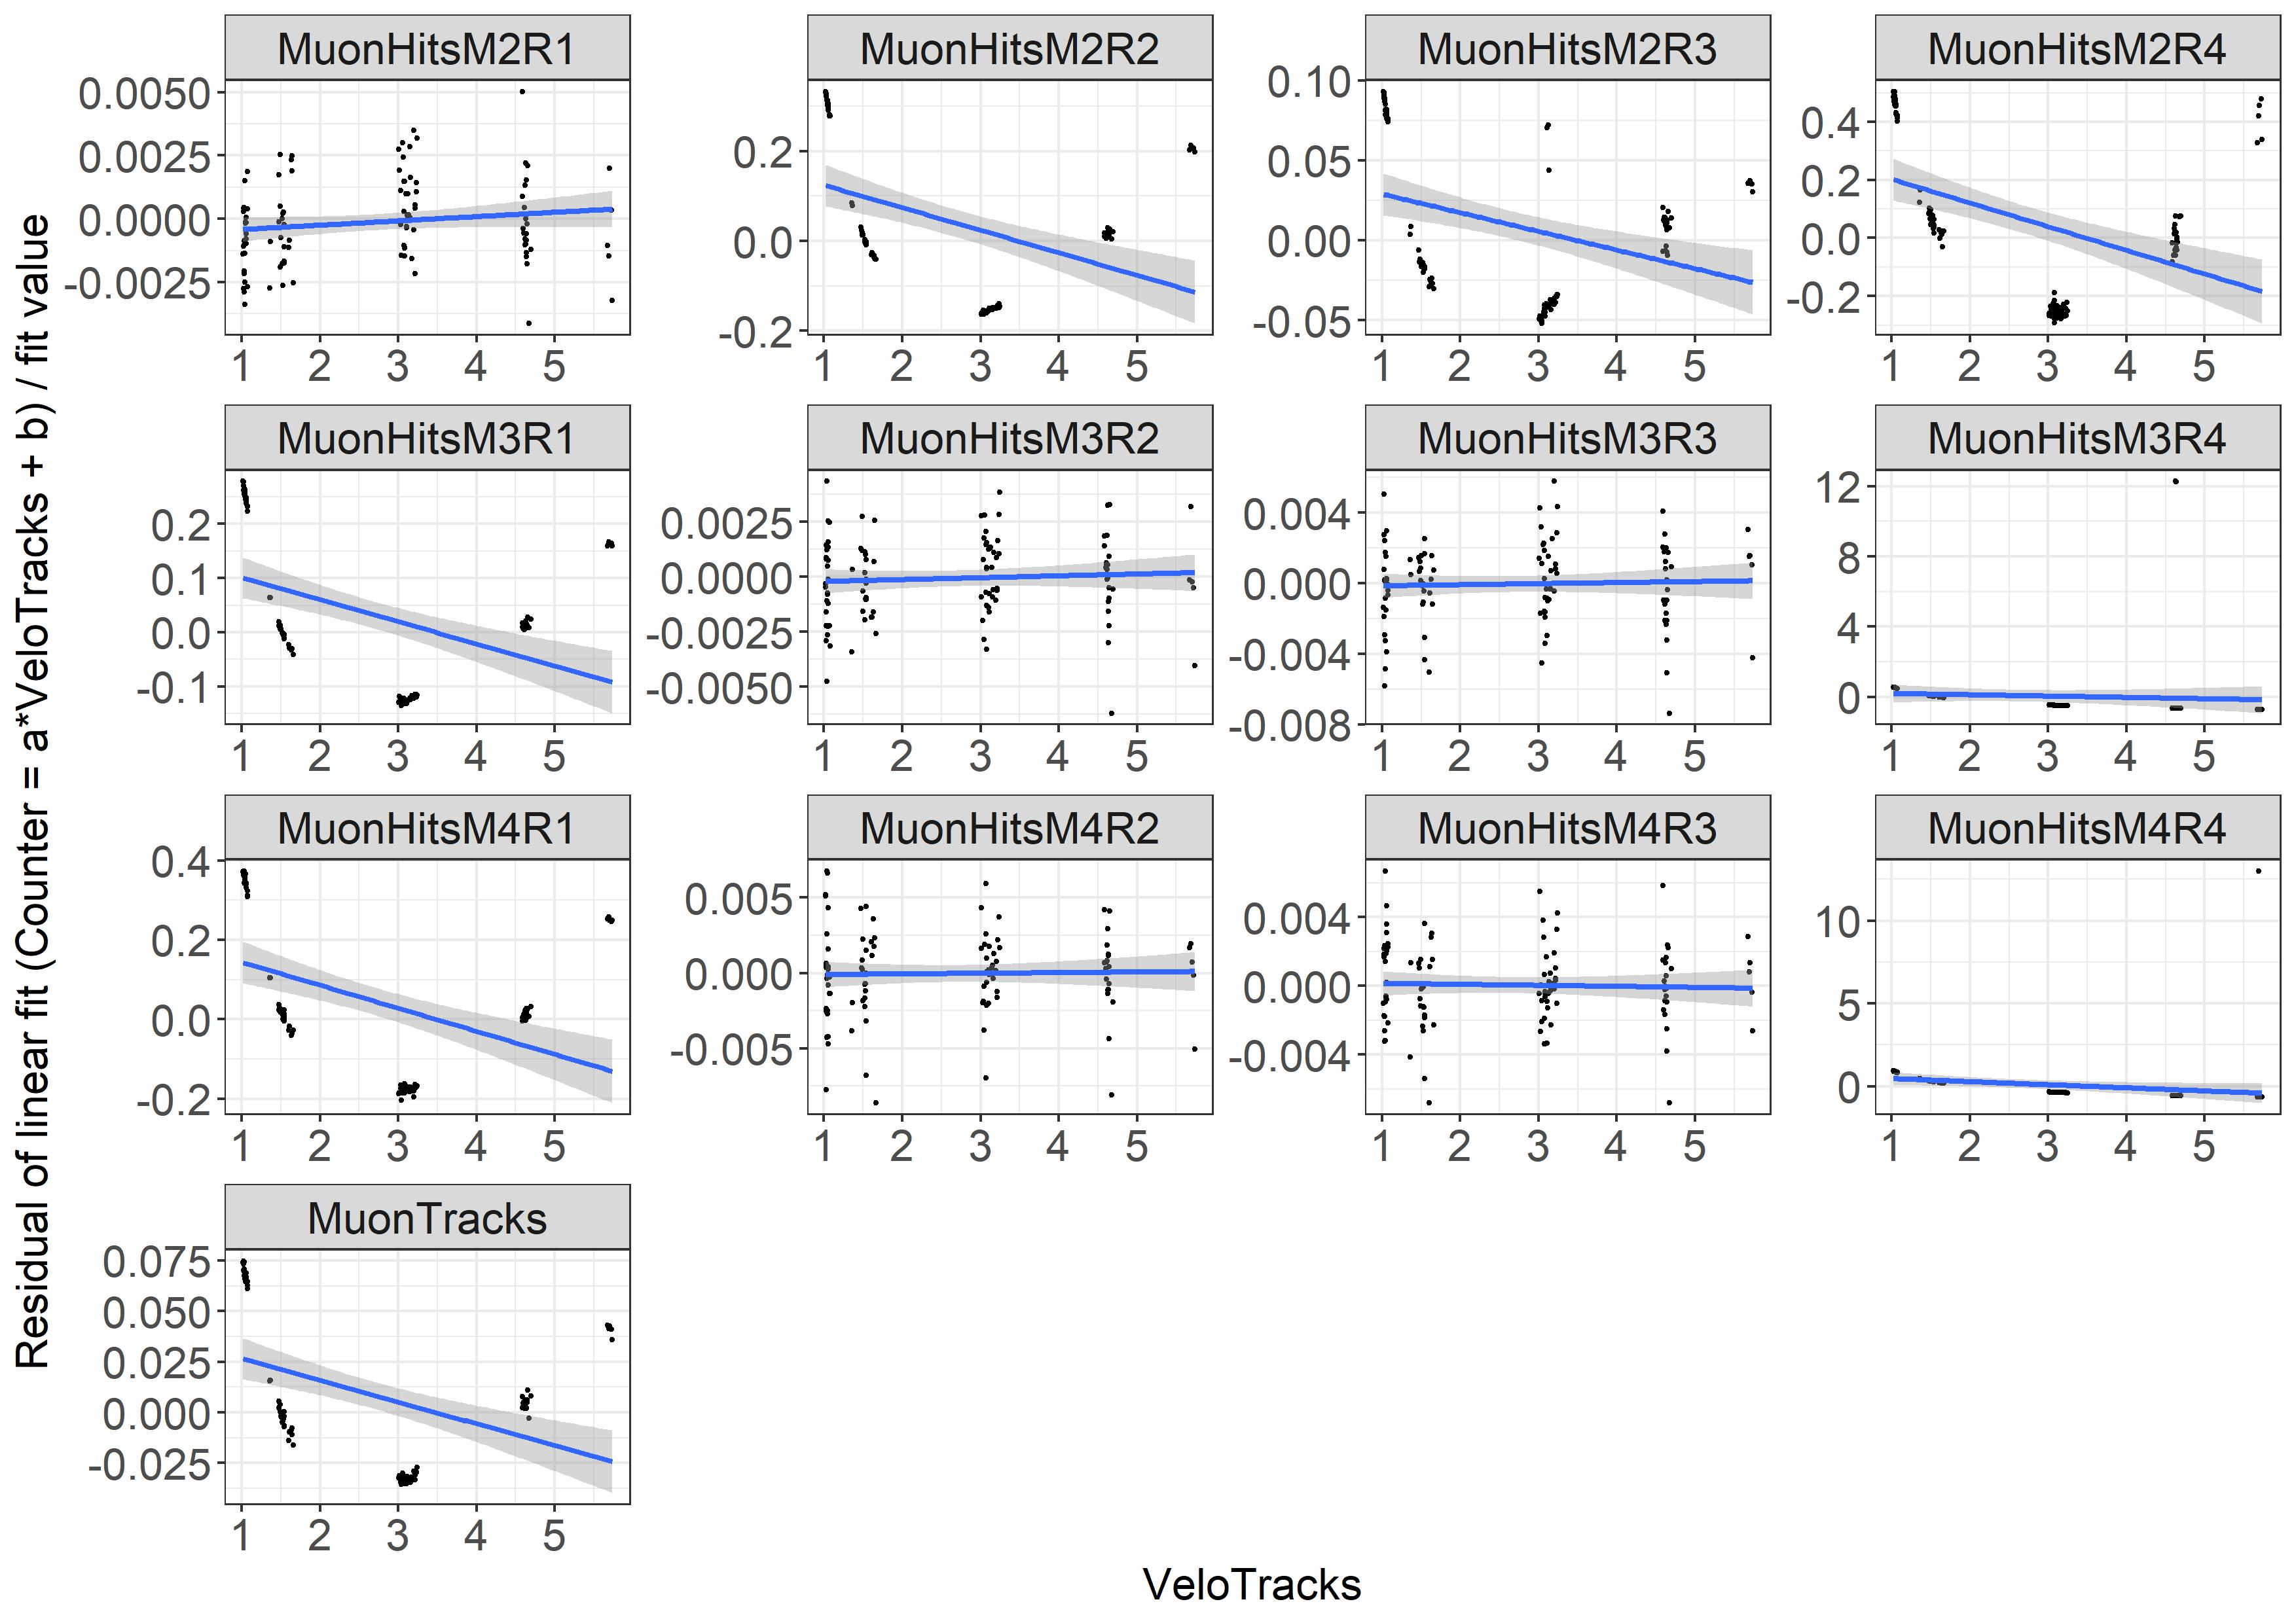
Comparison of Tracks vs. Vertices
VeloTracks better performance than VeloVertices! (MuonHits and VeloTracks seem to be the better pair of counters)

Slide 12
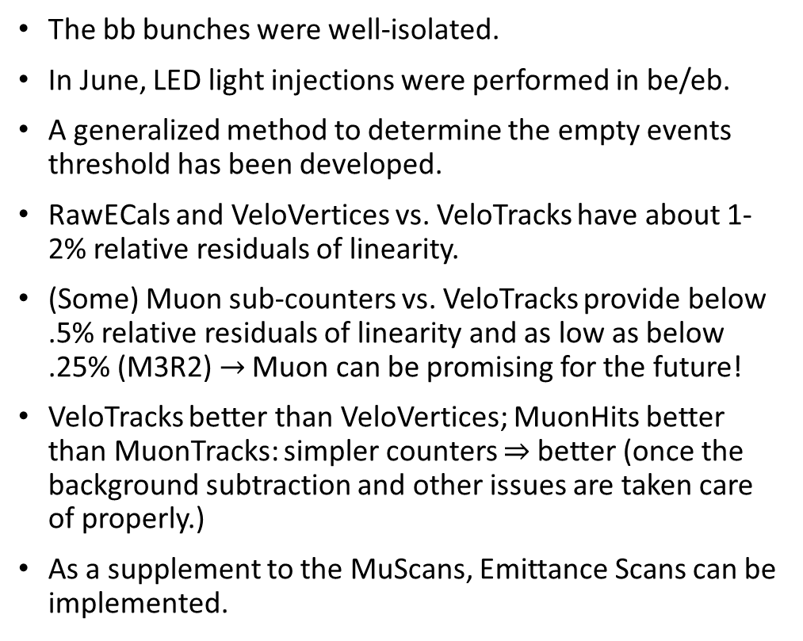
Conclusions
The bb bunches were well-isolated.
In June, LED light injections were performed in be/eb.
A generalized method to determine the empty events threshold has been developed.
RawECals and VeloVertices vs. VeloTracks have about 1-2% relative residuals of linearity.
(Some) Muon sub-counters vs. VeloTracks provide below .5% relative residuals of linearity and as low as below .25% (M3R2) $→$ Muon can be promising for the future!
VeloTracks better than VeloVertices; MuonHits better than MuonTracks: simpler counters $⇒$ better (once the background subtraction and other issues are taken care of properly.)
As a supplement to the MuScans, Emittance Scans can be implemented.

Slide 13
GitHub Repository
GitHub repository: OSSaimum/LHCb_Lumi (github.com)
Includes all my codes for this analysis. Further detailed descriptions of the generalized cut function and others are explained.
As my internship ends next week, I’ll also include my internship report and the codes that I’ve used for ECal and SciFi reports earlier this year in the coming days.
Any suggestions and feedback are most appreciated☺
And I would be glad to participate in other opportunities to contribute to the LHCb Luminosity group in the future☺

Slide 14
Additional Slides

Slide 15
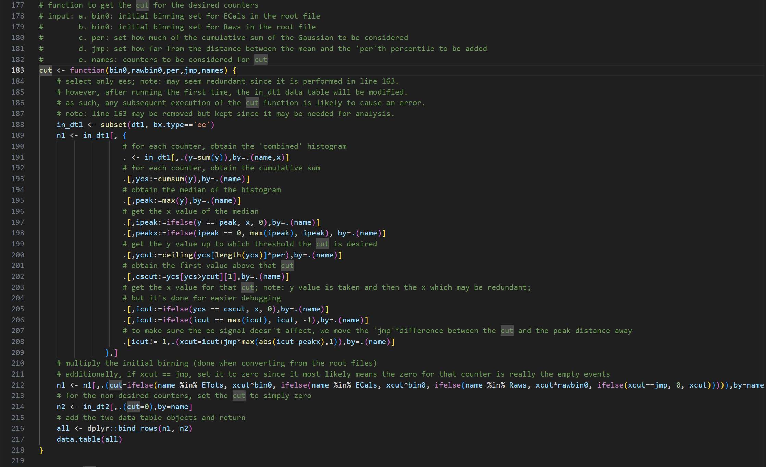
The cut()

Slide 16
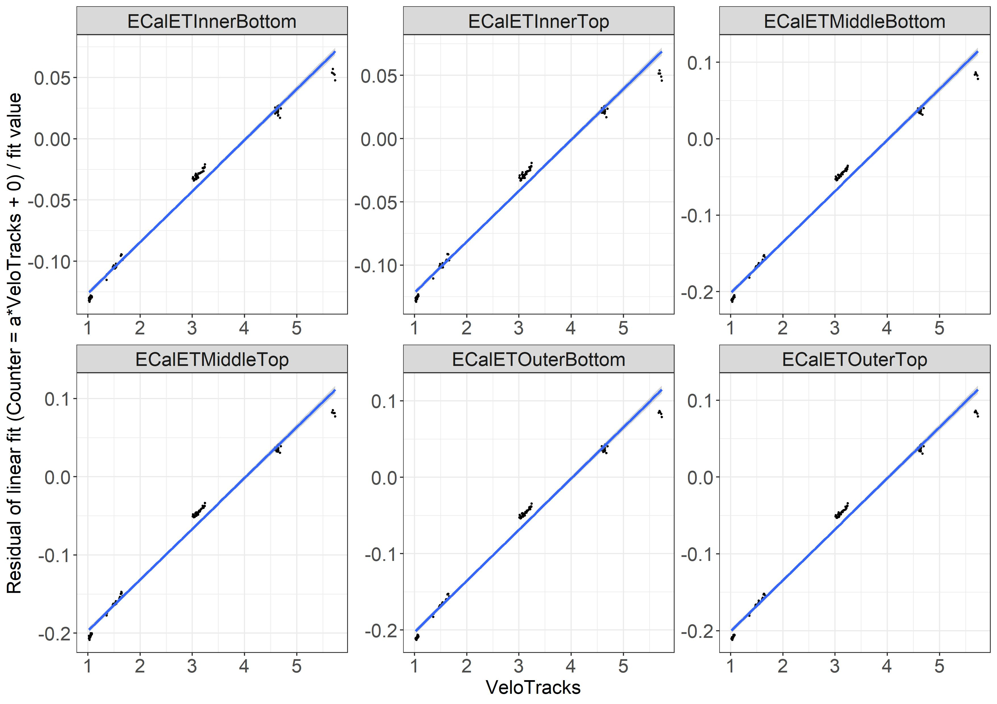
Setting offset to 0
ECals behave ‘less linearly’ w/ increasing mu

Slide 17
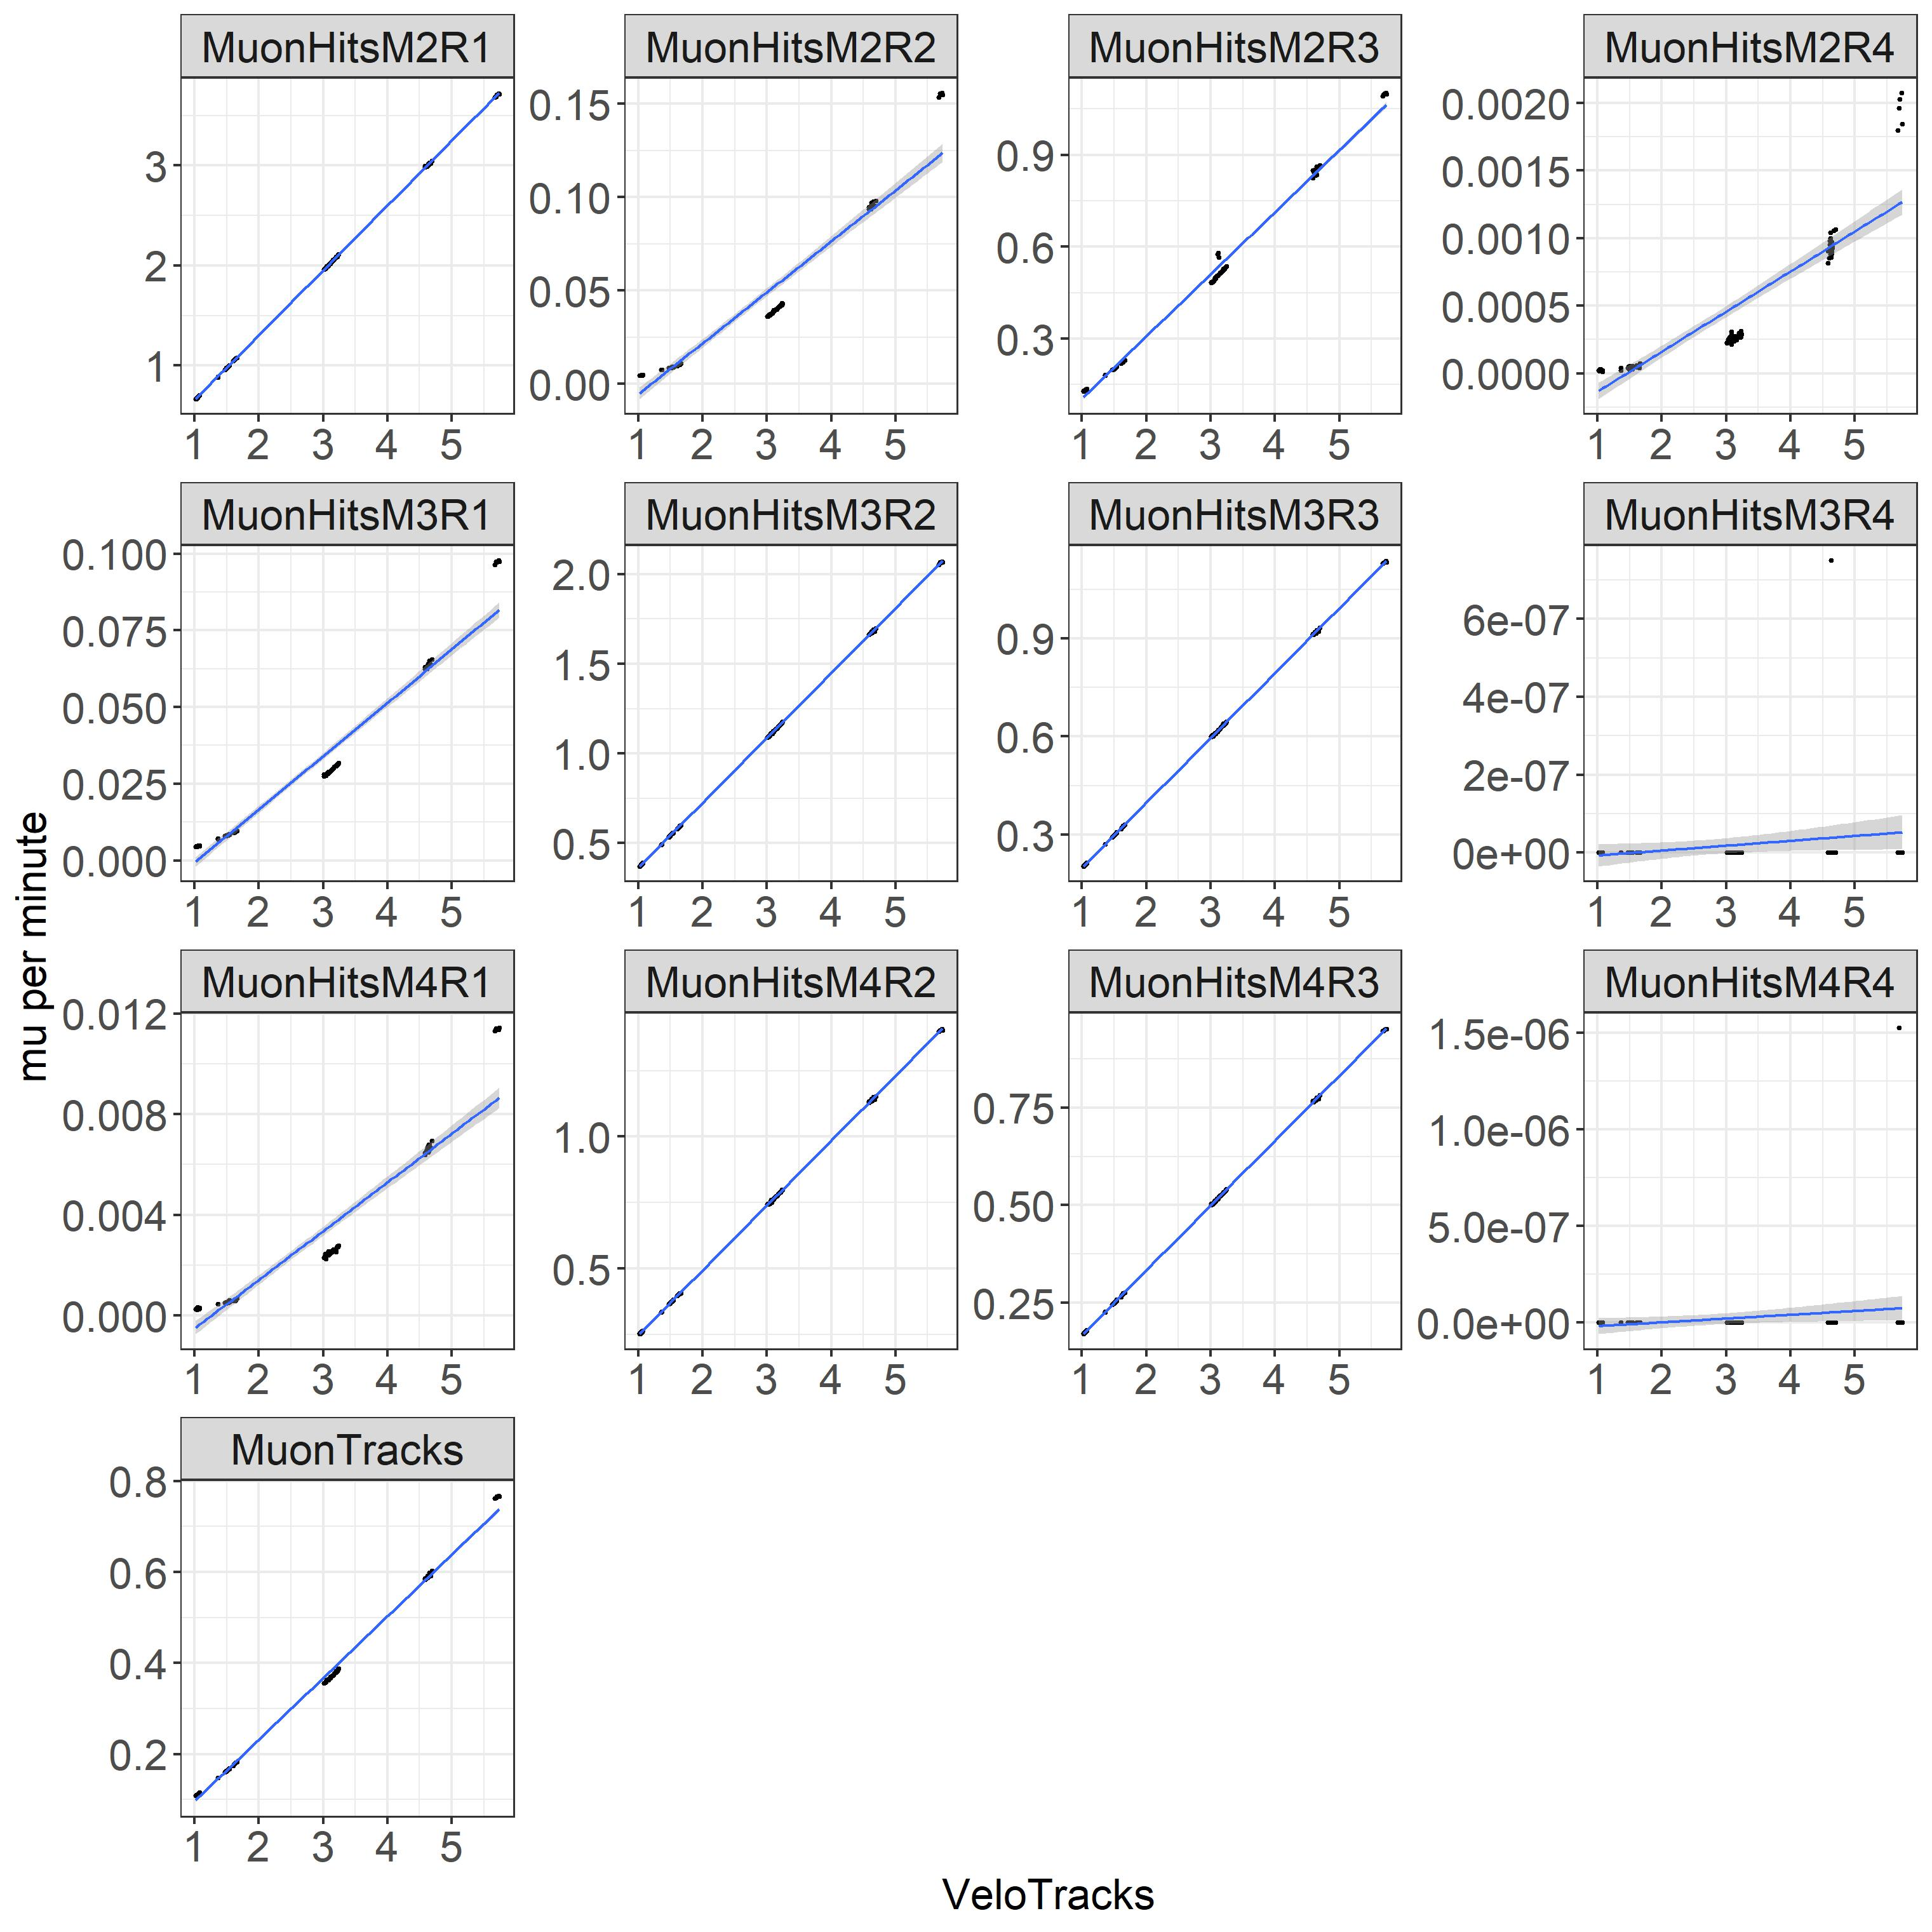
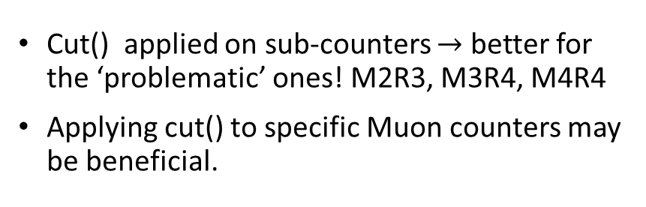
Using cut() for Muons
Cut() applied on sub-counters $→$ better for the ‘problematic’ ones! M2R3, M3R4, M4R4
Applying cut() to specific Muon counters may be beneficial.

